Slide 1
IIoT: Industrial Internet of Things PART - I

Slide 2
TOPICS TO BE COVERED
INTRODUCTION
IIoT REQUIREMENTS
DESIGN CONSIDERATIONS
DIFFERENCE B/W IoT & IIoT
SERVICE MANAGEMENT IN IIoT

Slide 3
“IoT as a concept has crossed the chasm from slideware to reality with many industries implementing IoT solutions.”

Slide 4
INTRODUCTION
The main aim of Internet of Things (IoT) is
to globally connect smart ‘things’ or ‘objects’.
objects are uniquely identified.
interoperability among the objects.
The Industrial Internet of Things (IIoT) is an application of IoT in industries to modify the various existing industrial systems. IIoT links the automation system with enterprise, planning and product lifecycle.

Slide 5
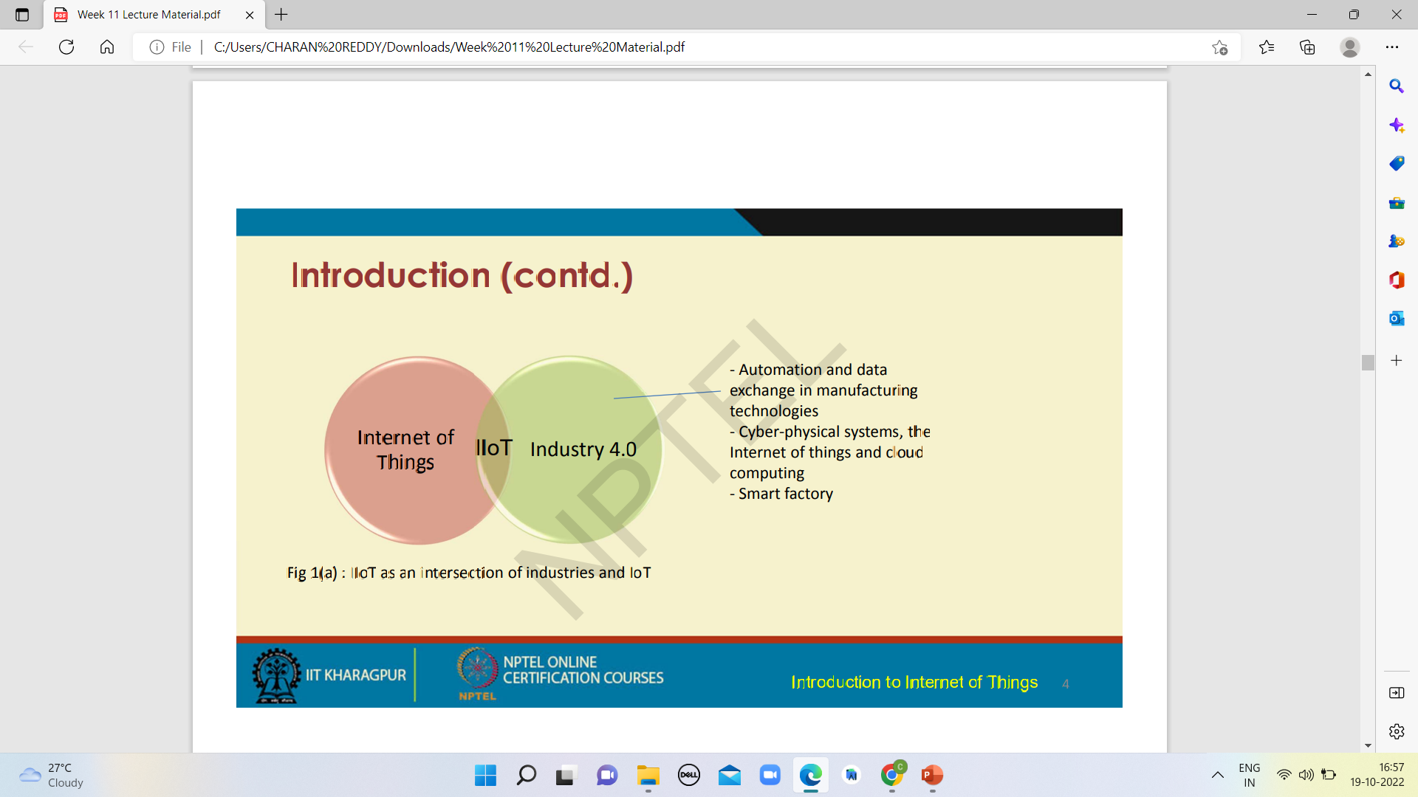

Slide 6
IIoT includes –
machine learning
big data technology
machine ‐ to ‐ machine interaction (M ‐ 2 ‐M)
AUTOMATION
IIoT is supported by huge amount of data collected from sensors. It is based on “wrap & re ‐use” approach, rather than “rip & replace” approach.

Slide 7
INTRODUCTION
1st Industrial Revolution: Mechanized production
2nd Industrial Revolution: Mass production
3rd Industrial Revolution: Internet evolution and automation
4th Industrial Revolution: IIoT

Slide 8
IIoT is a network of
Physical objects
systems
platforms
applications
These networks can communicate with each other, the external environment, and other people.
The acquisition of IIoT has led to the availability and affordability of sensors, processors, and other technologies which facilitates capture and access to real-time information Introduction to Internet of Things 9 N

Slide 9
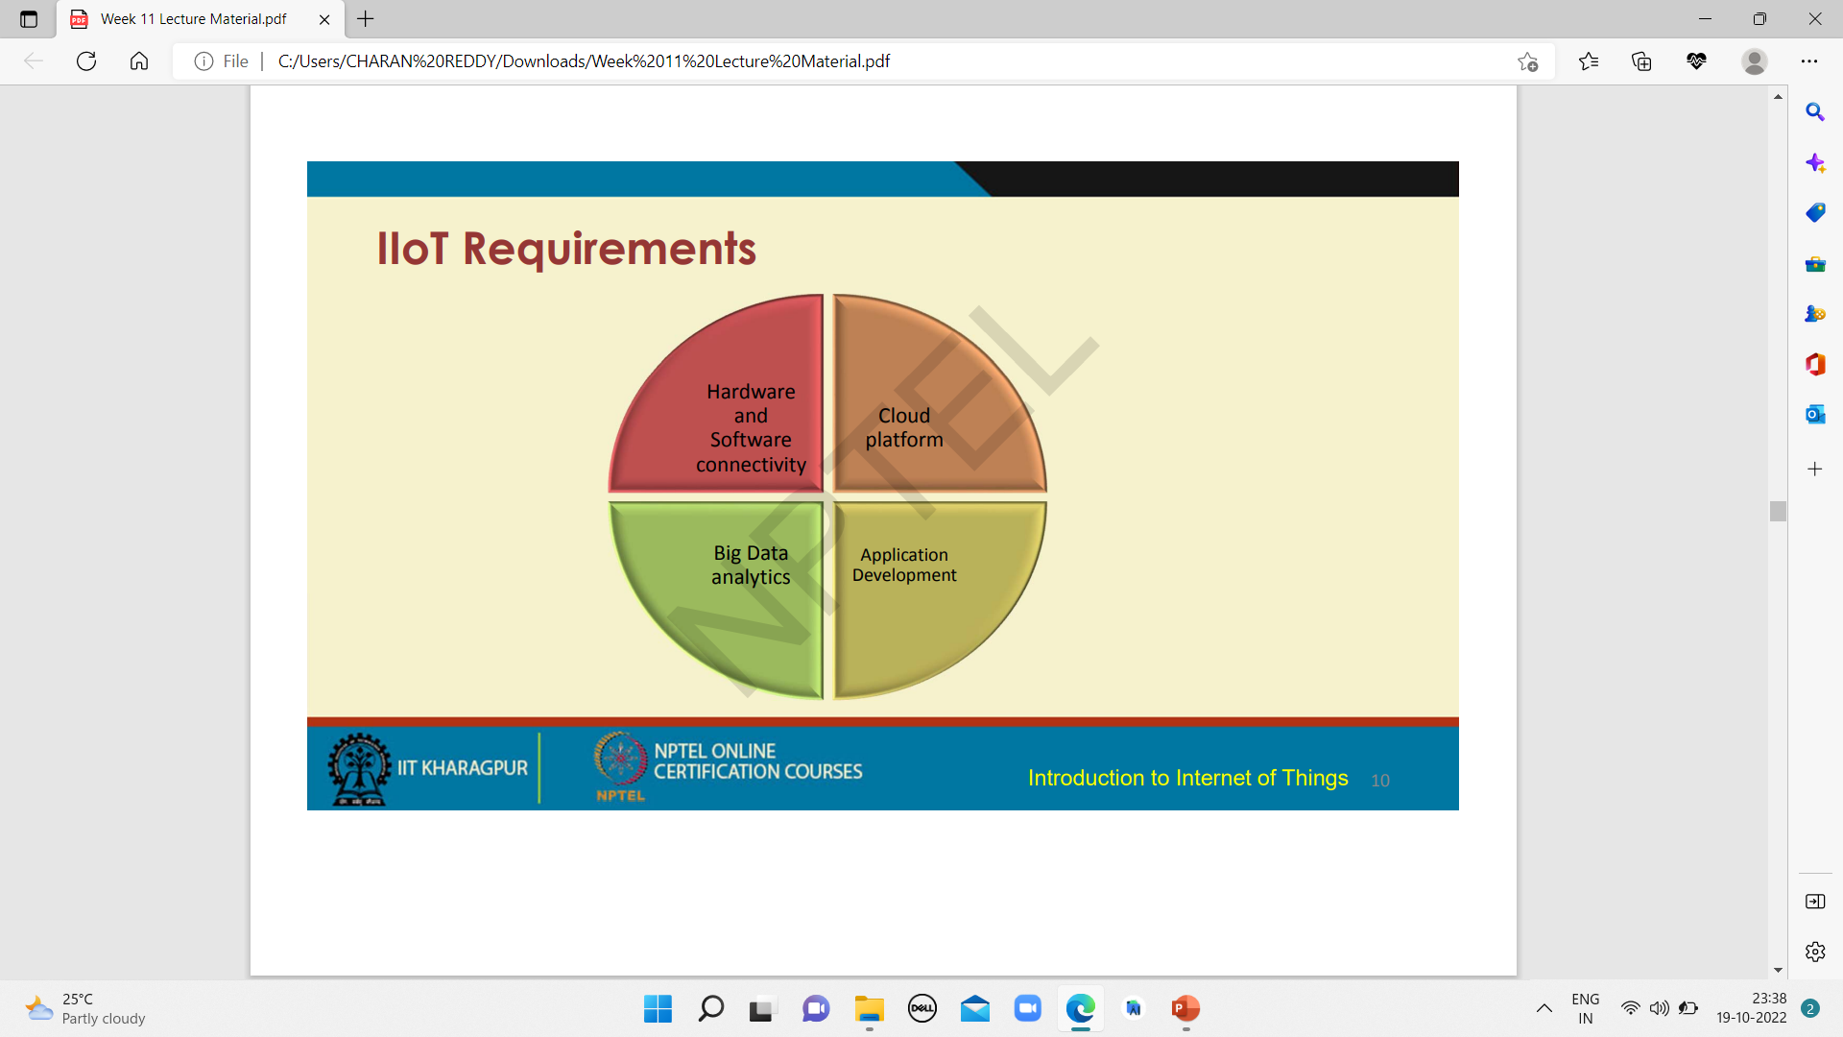
IIoT REQUIREMENTS

Slide 10
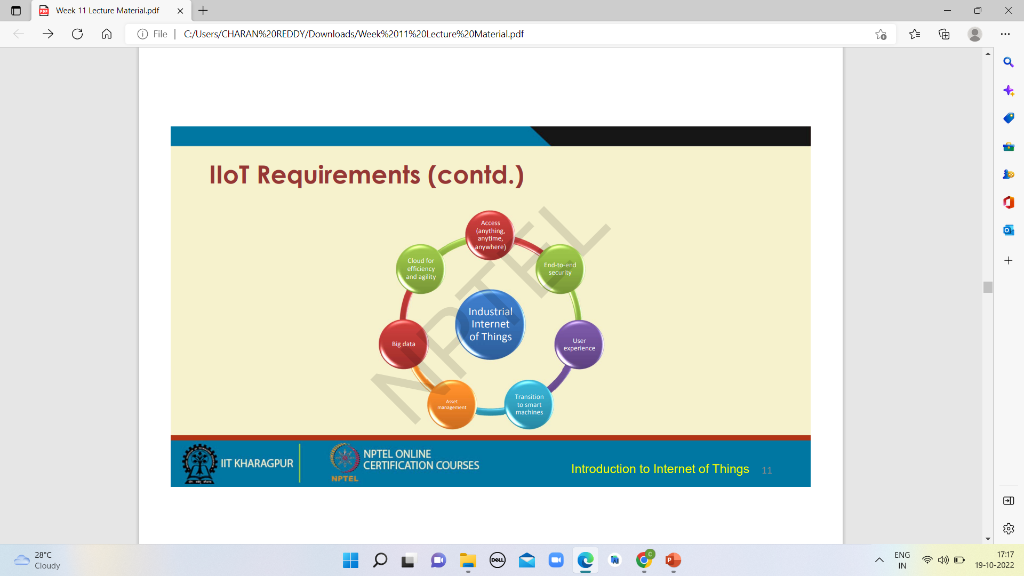

Slide 11
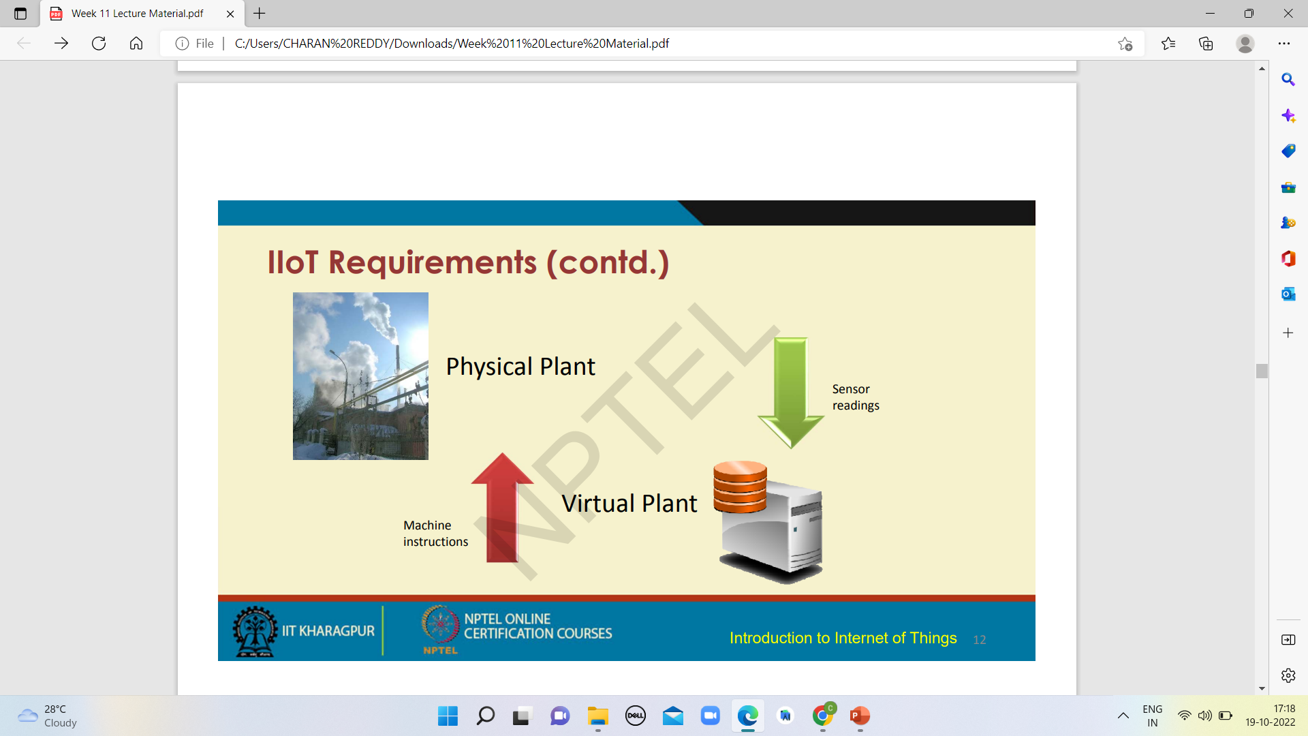

Slide 12
Design Considerations
To use an IoT device for industrial applications, the following design objectives are to be considered –
Energy: Time for which the IoT device can operate with a limited power supply.
Latency: Time required to transmit the data.
Throughput: Maximum data transmitted across the network.
Scalability: Number of devices supported.
Topology: Communication among the devices, i.e. interoperability.
Safety and Security: Degree of safety and security of the application.

Slide 13
Difference between IoT and IIoT
IoT
IIoT
Focused on the convenience of individuals
M ‐ 2 ‐ M communication: Limited
Applications areas are at the consumer ‐level
Focused on efficiency, safety, and security of the operation.
M ‐ 2 ‐ M communication: Extensively.
Application areas are in industries

Slide 14
Service Management in IIoT
“Service management refers to the implementation and management of the quality of services which meets the end ‐users’ demand”
“Service is a collection of data and associated behaviors to accomplish a particular function or feature of a device or portions of a device”.

Slide 15
Service Management in IIoT
Service can be of two types, which are ‐
Primary service ‐ The basic services which are responsible for the primary node functions are termed as primary services.
Secondary service ‐ The auxiliary functions which provide services to the primary service or secondary services are termed As secondary service

Slide 16


